Slide 1

Jane
Business owner
Earns $100,000
45 years old
Thinks our products and service are great

Slide 2
Peter
Individual
Earns $40,000
30 years old
Thinks our products and service are great

Slide 3

How can data mining influence how we sell to Jane and Peter?

Slide 4

Predict incomplete survey brand responses
A customer’s brand preference is dependent on their age and salary
Notes:
We were asked to complete an incomplete survey.
The missing information was whether or not the respondent preferred Sony or Acer.
To perform the task, we needed to analysis if certain attributes influence whether or not a customer prefers one brand or the other.
We got results that indicate age and salary are relevant factors for determining brand preference.
# var imp charts

Slide 5
Sony or Acer?
1. Jane prefers Acer
2. Peter prefers Sony
Notes:
So what can we say about Jane and Peter?
From this graph we can see that given their ages and salaries, Jane is likely to prefer Acer while Peter will probably prefer Sony.
However, both incomplete and complete data sets distributions were not optimal for predictions due to the fact it was not random.
Even so this data set is perfect for customer profile as shown
#Different models used and different results and the errrors

Slide 6
Factors that influence sales volumes
How important is the quality of our services and products to Jane and Peter?
Notes:
Jane and Peter are typical Blackwell’s customers in that they value our customer service and quality products.
In another piece of analysis, we found good customer service and quality products not only keep our customers happy, our sale volumes are more dependent on them than the prices we charge.
*# Appendix show importance of the variables

Slide 7
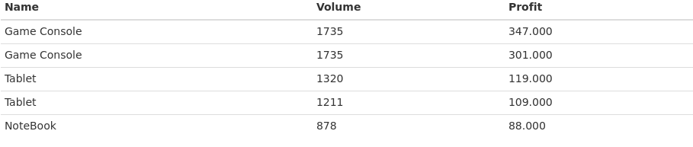
Good quality service and products lead to more profits
Notes:
What we can see here from the same analysis is the effect that good service and quality products have on profits.
This table shows the predict sales of five potential products and the figures are impressive.

Slide 8
Sales predictions
Product type | Sales volume
Netbook | 1257
Smartphone | 888
PC | 438
Laptop | 207
Notes:
This table shows the predict sales of the four products we were asked to look into.
One word of caution, this analysis was based on a very small sample.
A large dataset would give more accurate results. Even so, this demonstrates what the data analysis is capable of.

Slide 9
Increased sales
Positive service reviews
Positive product reviews
Notes:
In summary, positive service reviews and products reviews increase sales.

Slide 10
B2B shopping habits
Accessories + Software -> Display
PC + Software -> Display
Laptop + Software -> Display
Laptop + Printer Supplies -> Display
Printer + Tablet -> Display
Notes:
Back to Jane and the products she buys as a business owner.
We were asked to analysis the transactions of Electronidex, the online retailer that we are considering buying.
This slide shows the buying patterns of B2B customers, like Jane.
We can see here that if she buys the products in red, she is likely to then go on to buy a display which is one of Blackwell's most profitable products.
And we will pick up repeat transactions from customers that tend to be loyal and buy in bulk.
# Rules with the lifts etc.

Slide 11
B2C shopping habits
Printer + Printer Supplies -> Accessories
Display + Printer Supplies -> Accessories
Laptop + Printer Supplies -> Accessories
PC + Printer Supplies -> Accessories
Software + Tablet -> Accessories
Notes:
Turning to Peter, our B2C customer.
If customers like Peter buy the items in red, they tend to go on to buy accessories.
# Rules with the lifts etc.

Slide 12
The accessories dilemma
Why buy a company that also sells a lot of accessories when they are not profitable?
Notes:
While the conclusions from our analysis of Electronidex’s transactions may look promising, they do raise a very important question.
Accessories are our biggest selling product in terms of volume but they generate the least profit.
The question is why buy a company that also sells a lot of accessories when they are not profitable?

Slide 13

The accessories dilemma
“The best investment you can make, an investment in yourself.
The more you learn, the more you’ll earn.”
Warren Buffett
The answer: basket analysis of our transactions
Notes:
A way of finding an answer to this dilemma is to conduct a basket analysis of our transactions.
To misquote Warren Buffet here, investing in data analysis leads to better decisions and higher profits.

Slide 14
Should we buy Electronidex?
More research required to give an informed recommendation
Notes:
While buying Electronidex would bring us more customers matching the profiles or Jane and Peter, the decision would benefit from further research.
Ideally, we would like to know the timeframe in which the transactions were made. This is unspecified so don’t know if sales figures are influenced by days such as Black Friday or Christmas.
It would be prudent to see Electronidex’s figures on profit margins, most profitable products and spend-per-transaction.
And it is very important that we do a comparable analysis with comparable Blackwell data.

Slide 15

What can data mining tell us about the future?
Notes:
Build better customer profiles and targeting of customers based on their preferences
Cross-selling campaigns
Predicting the success and profitability of new items
Make loss leaders more efficient

Slide 16
Insights and conclusions
1. Better datasets will produce better results
2. More research needed on Electronidex
3. Understand the role of accessories in Blakwell’s sales strategy
Notes:
1. A random sample of customers would generate more accurate predictions about their brand preferences.
2. Bigger sample sizes would give us a better idea of the factors that influence sales volumes.
3. Electronidex analysis had to make a number of assumptions because of a lack of information including how to accurately divide the data into B2B and B2C customers. We split the transactions into B2B if it included two or more Laptop, Desktop, Monitor, Printer and Mouse/Keyboard. But this is an assumption and it could be divided differently.
#

Slide 17

Thank you.
Stacey Jackson
José Pedro Conceição

Slide 18

Appendix
Notes:
Build better customer profiles and targeting of customers based on their preferences
Cross-selling campaigns
Predicting the success and profitability of new items
Make loss leaders more efficient

Slide 19
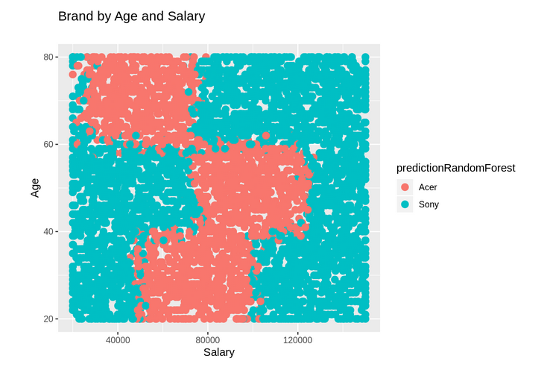
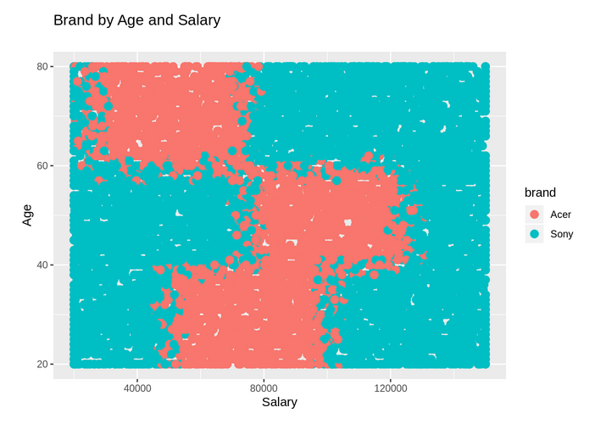
Brand by age and salary

Slide 20
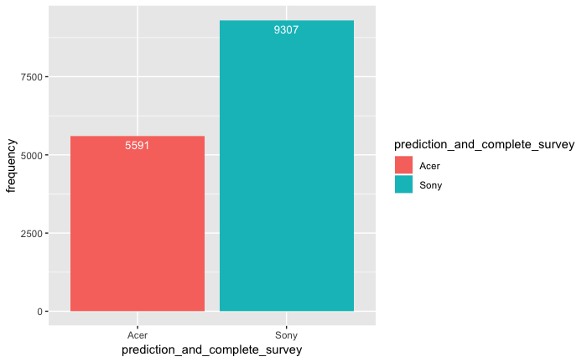
Predicted preference

Slide 21
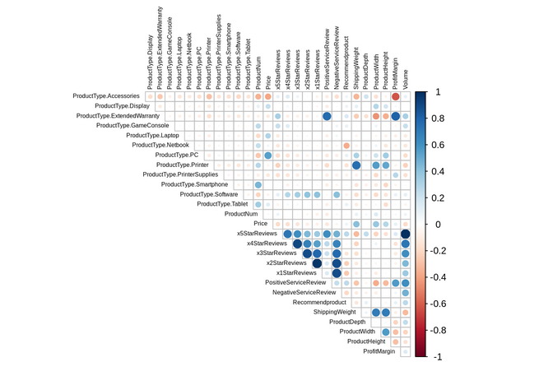
Correlation between the variables

Slide 22
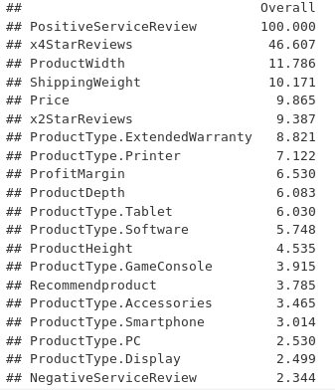
Brand preference: importance of the variables

Slide 23
Rules for B2B customers
First products added to basket | Final product added to basket | support | confidence | lift | #Trans.
Accessories, Software | Display | 0,109 | 0,723 | 1,238 | 500
PC, Software | Display | 0,102 | 0,739 | 1,266 | 470
Laptop, Software | Display | 0,090 | 0,723 | 1,240 | 413
Laptop, Printer Supplies | Display | 0,052 | 0,741 | 1,269 | 240
Printer, Tablet | Display | 0,031 | 0,809 | 1,386 | 144
Printer, Software | Display | 0,031 | 0,797 | 1,365 | 141

Slide 24
Rules for B2C customers
First products added to basket | Final product added to basket | support | confidence | lift | #Trans.
Printer, Printer Supplies | Accessories | 0,005 | 0,889 | 1,409 | 24
Display, Printer Supplies | Accessories | 0,010 | 0,815 | 1,292 | 53
Laptop, Printer Supplies | Accessories | 0,012 | 0,778 | 1,233 | 63
PC, Printer Supplies | Accessories | 0,012 | 0,747 | 1,184 | 62
Software, Tablet | Accessories | 0,003 | 0,818 | 1,297 | 18

Slide 25
Blackwell’s sales volume, profit margin & product type

Slide 26
Electronidex’s biggest sellers by product type

